Slide 1
Week5 Project
Kaiye Chen

Slide 2
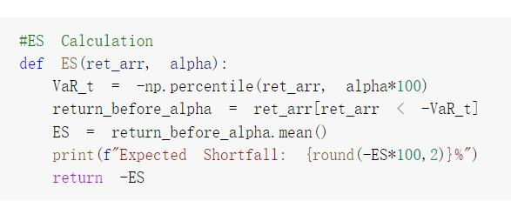
Problem1: Expected Shortfall
An extension of VaR
Using the mean of below VaR

Slide 3
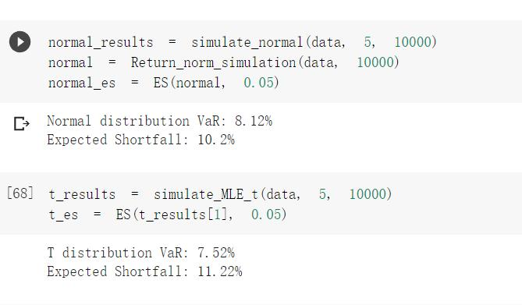
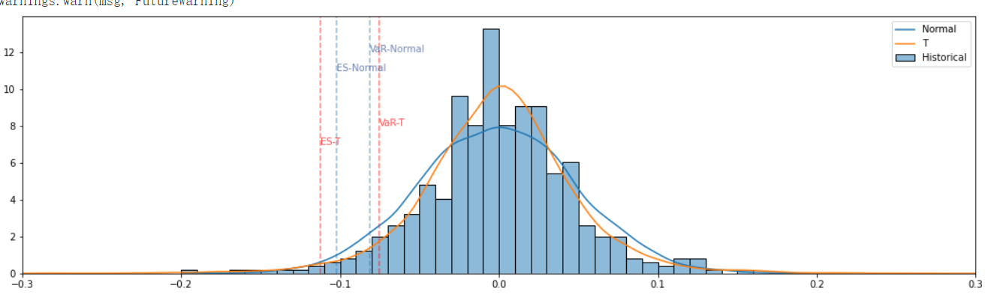
Problem1: Results
T-distribution: High VaR, low ES
Reason: T is fat-tail and high kurtosis

Slide 4
Problem2: Refactoring
No necessity to show codes
In this stage: Refactoring in this week’s homework notebook
In the future: Create a package for all the related codes

Slide 5
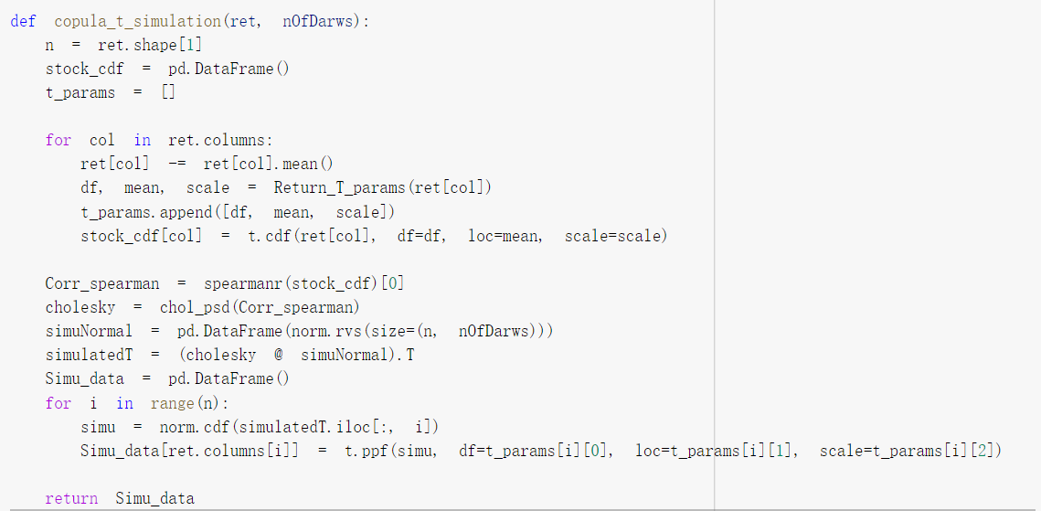
Problem3: Copula Method
Based on the cholosky decomposition of correlation
Combined different distribution estimation

Slide 6
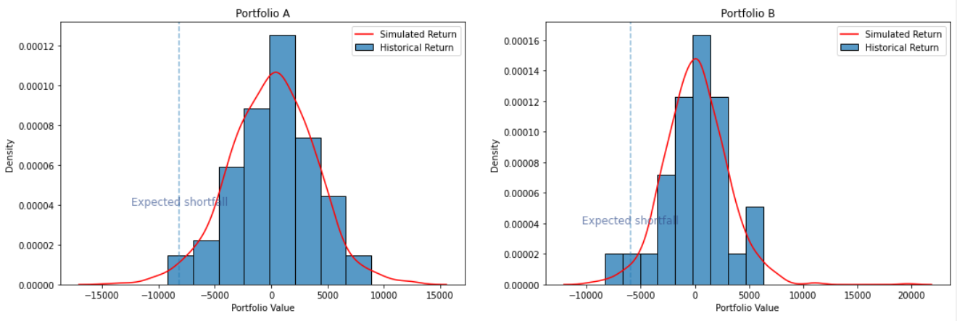
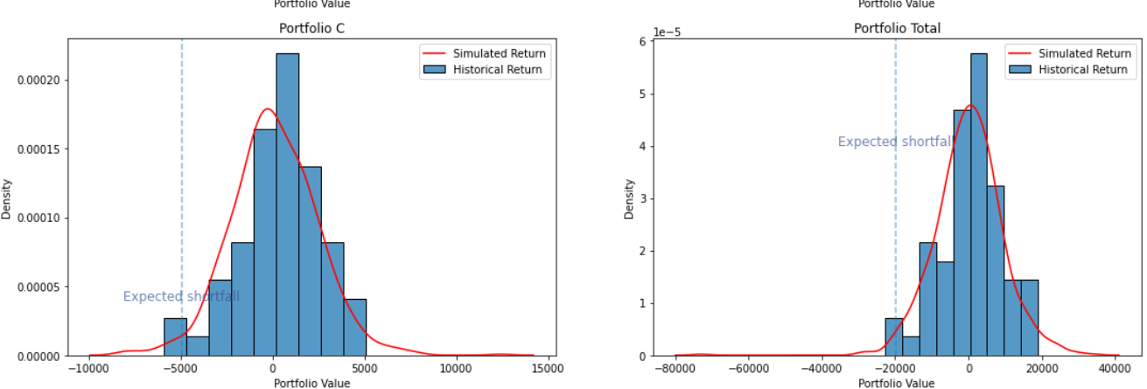
Problem3: Results

Slide 7
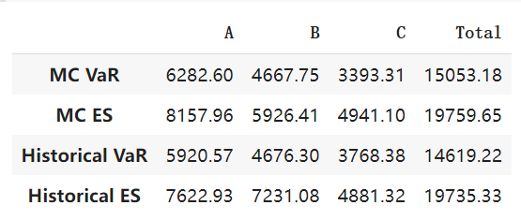
Problem3: Results
Copula Method is better, since not all distribution are normal
Still subaddictive

